Slide 1
Web Science
Web Ranking Algorithms
Group：1
Date：10/8/2019
Lee
Alvin
Sam
Mircale

Slide 2
01
01
Introduction
02
02
Related Work
03
03
Methods
04
04
Experiment
06
06
Reference

Slide 3

Introduction

Slide 4
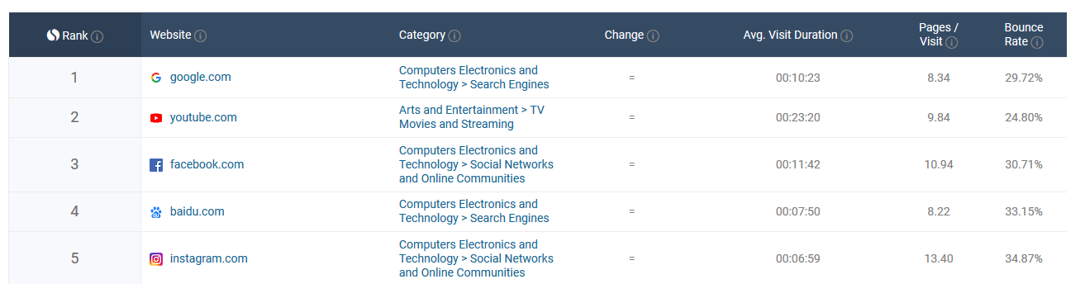
Background
What is page ranking?
Rank web pages by weighing their quaility, pivotal function, value and any other treasurable factors.

Slide 5
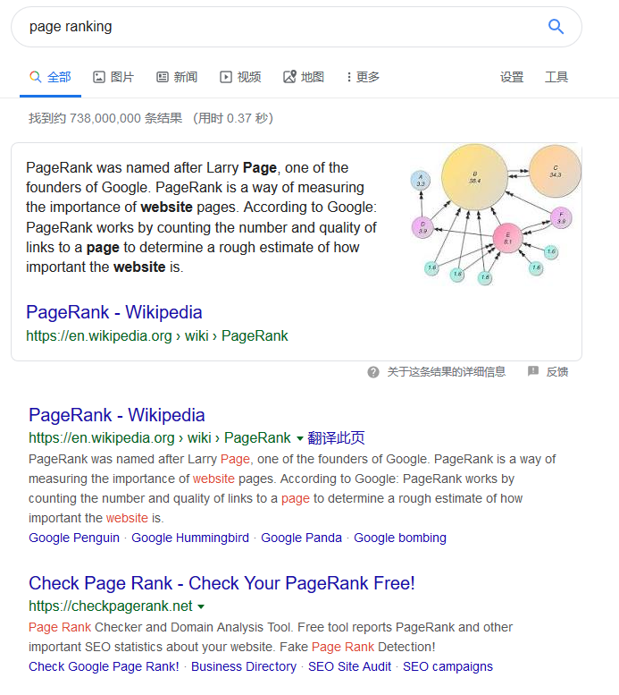
Background
Why?
Search engine can list pages with highest relevance to the search key.
Seek more websites which can be trusted
Web pages can be categorized by their performance in linking(such as some hubs)

Slide 6
Problem
Implement algorithms below:
PageRank
Topic-sensitive PageRank
SALSA and TKC effect
TrustRank
Dynamic Personalized PageRank

Slide 7

Related Work

Slide 8
Related Work
Random walk model
Hub and Authority
Dynamic Personalized PageRank
PageRank
HITS
extend(user preference)
combine
extend(category indicate)
extend(seed page)
Topic-sensitive PageRank
SALSA
TrustRank

Slide 9

Methods

Slide 10

PageRank
Idea
1.If a web page is linked to by many other web pages, it means that the web page is relatively important, which means that the PageRank value will be relatively high.
2.If a page with a high PageRank is linked to another page, the PageRank of the linked page will be correspondingly increased related works.
Notes:
1.If a web page is linked to by many other web pages, it means that the web page is relatively important, which means that the PageRank value will be relatively high.
2.If a page with a high PageRank is linked to another page, the PageRank of the linked page will be correspondingly increased related works.

Slide 11
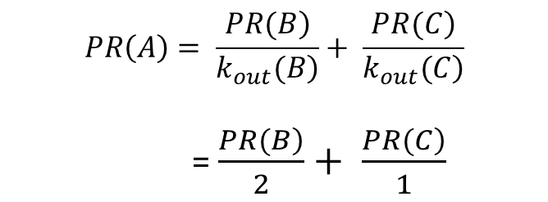
PageRank Basic Idea 1
A
B
$$PR\left(A\right)= \frac{\left.PR(B\right)}{\left.k_{out}(B\right)}+ \frac{\left.PR(C\right)}{\left.k_{out}(C\right)}$$
= $\frac{\left.PR(B\right)}{2}+ \frac{\left.PR(C\right)}{1}$
C
D

Slide 12
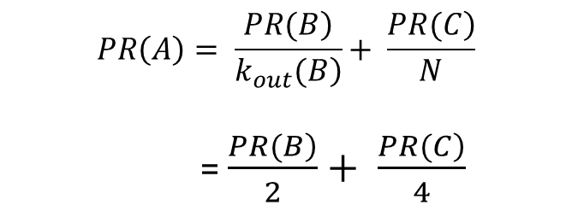
PageRank Basic Idea 2
A
B
$$PR\left(A\right)= \frac{\left.PR(B\right)}{\left.k_{out}(B\right)}+ \frac{\left.PR(C\right)}{N}$$
= $\frac{\left.PR(B\right)}{2}+ \frac{\left.PR(C\right)}{4}$
C
D
No way out

Slide 13
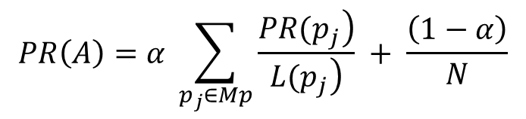
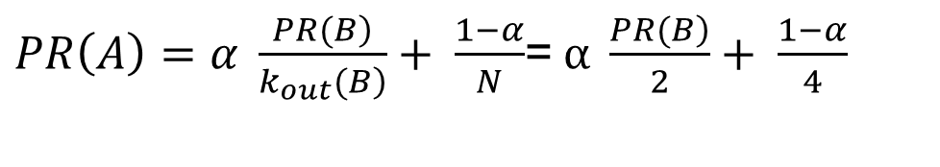
PageRank Basic Idea 3
A
B
Point to itself
$PR\left(A\right)=α \frac{\left.PR(B\right)}{\left.k_{out}(B\right)}+ \frac{1−α}{N}$=$α \frac{\left.PR(B\right)}{2}+ \frac{1−α}{4}$
C
D
α is coefficient of correction
In general, the PR value of a web page is calculated as follows:
$$PR\left(A\right)=α \sum_{p_{j}∈Mp}{\frac{\left.PR(p_{j}\right)}{\left.L(p_{j}\right)}} + \frac{\left(1−α\right)}{N}$$

Slide 14
TrustRank
Step 1.Seed determination
the website with the most export links (the probability of being chosen is high)
seed sites is to select sites with high PR value (appear on search results pages more frequently)

Slide 15
TrustRank
Step 2.Trust attenuation
Trust dampening method
β is dampening factor
Good seed
β
β²
1
β
2
3
β²
Value = 1
β
Walk one step
Walk one step
dampen factor and walk distance can be set

Slide 16
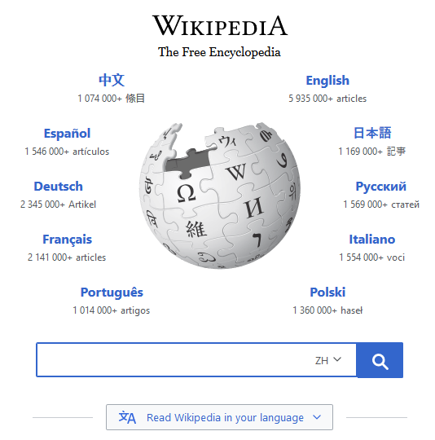
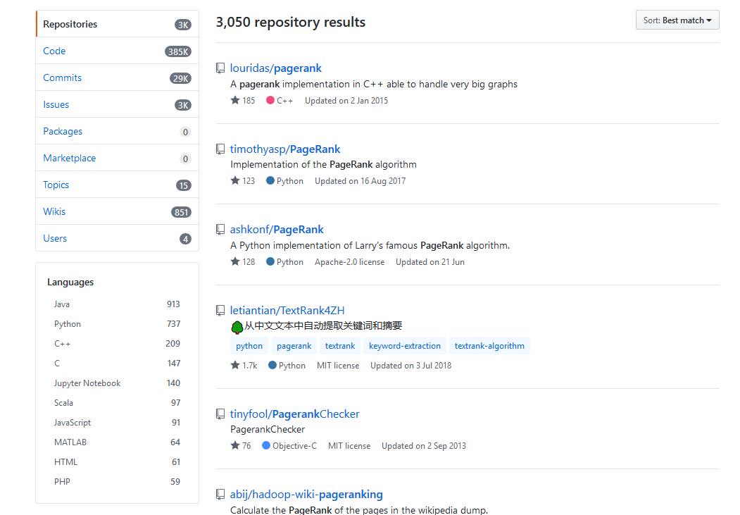
HIST
Two assumptions
A high quality hub page with high hub value
A high quality authority page with high authority value

Slide 17
HIST
Idea
1. Each page is given two attributes: the hub attribute and the authority attribute.
2. Web pages are divided into two categories: the hub page and the authority page.
Purpose
Return a high quality authority page to the user when the user queries.

Slide 18
Procedure
Step 1.Initiation
Set all pages' two attributes (authority and hub) as ,which N means the number of pages.
Step 2.Authority update
j₁
j₂
j₃
j₄
i

Slide 19
Procedure
Step 3.Hub update
i
j₁
j₂
j₃
j₄

Slide 20
HIST
Step 4.Normalization
We calculate authority values and hub values of all the pages. Then we process normalization.
Then iterate these four steps until convergence

Slide 21
SALSA
Idea
Take the advantages of both PageRank and HITS
Random walk model
Hub and authority categories.
Link Relation Propagation Process
Transfer connectivity
Form connected set

Slide 22
Procedure
Step 1.Categorize pages into two list
1
3
10
1
2
3
2
1
6
3
5
6
5
6
10
Hub list
Authority list

Slide 23
Procedure
Step 2.From Bipartite Graph
1
3
10
1
2
3
2
1
6
3
5
6
5
6
10
Hub list
Authority list

Slide 24
Procedure
Step 3.Find sub-connected graph in Authority list
1
1
2
3
As pivot
3
5
6
6
10
Hub list
Authority list

Slide 25
Procedure
Step 4.Calculate authority value
1
1
2
3
3
authority_sum = 4
connected_sum = 3
in_connected_sum = 6
in_node₅ _sum = 1
5
6
6
10
a₅=0.125
Hub list
Authority list

Slide 26

Experiment

Slide 27
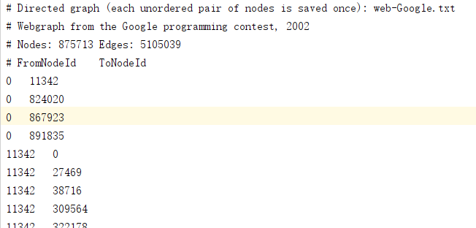
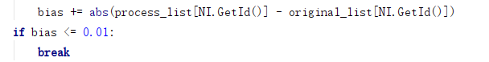
PageRank
Input
Google web graph
Iteration stop condition

Slide 28
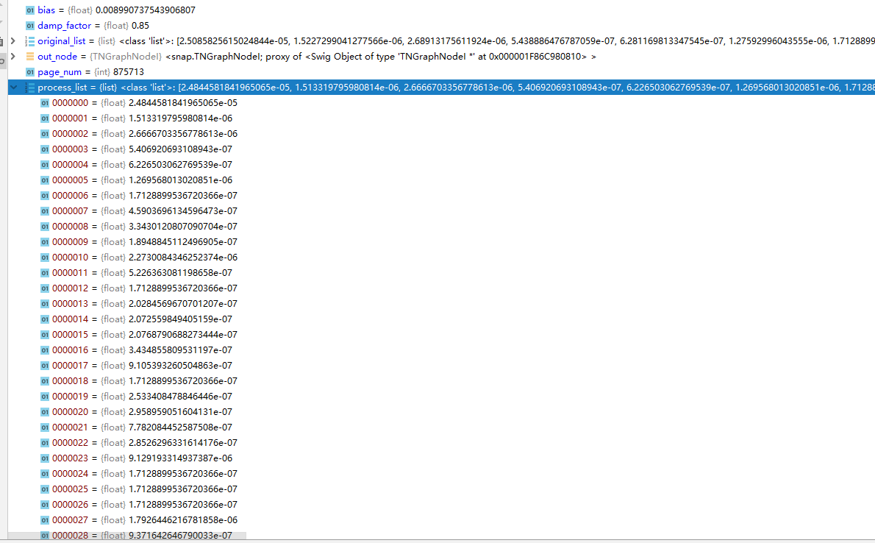
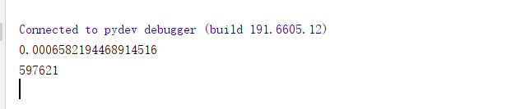
PageRank
Output
Higest PageRank value and its index
PageRank value list

Slide 29
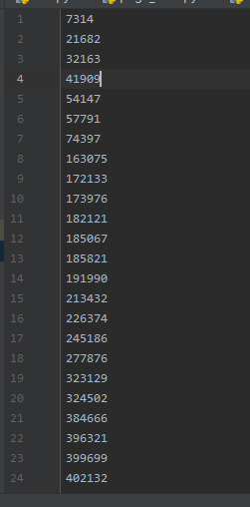
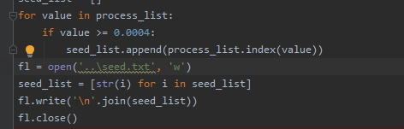
TrustRank
Input
Top 55 pages form Seed list ordered by PageRank

Slide 30
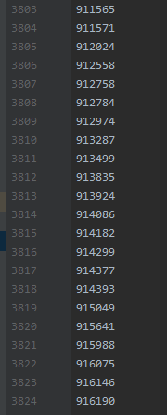
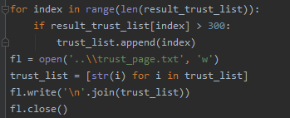
TrustRank
Output
3824 pages with high trust value

Slide 31
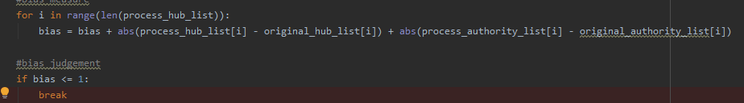
HITS
Input
Google web graph
Iteraton stop condition

Slide 32
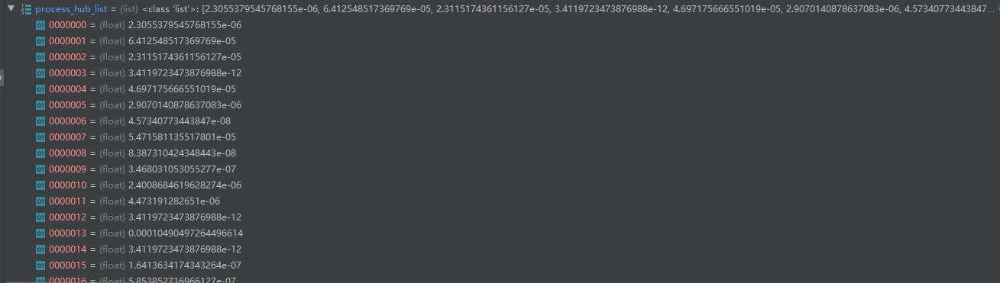
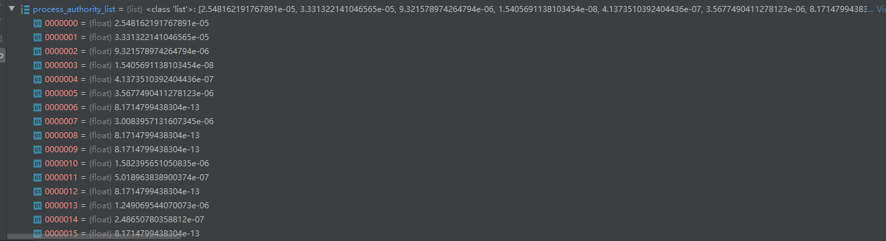
HITS
Output
hub_value list
authority_value list

Slide 33
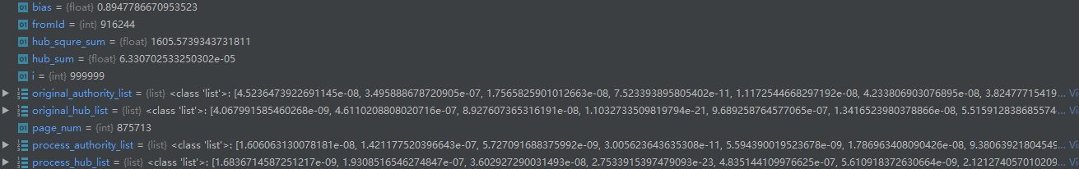
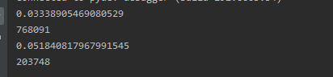
HITS
Output
bias
The page with highest authority(hub) value and its index

Slide 34
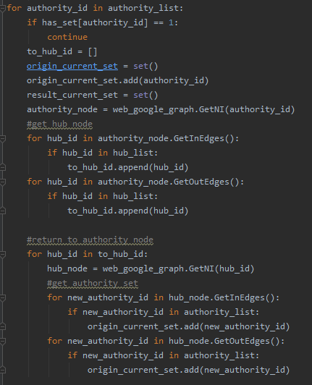
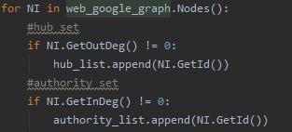
SALSA
1. Generate Hub set and Authority set
2. Random walk to form sets of connected graph

Slide 35
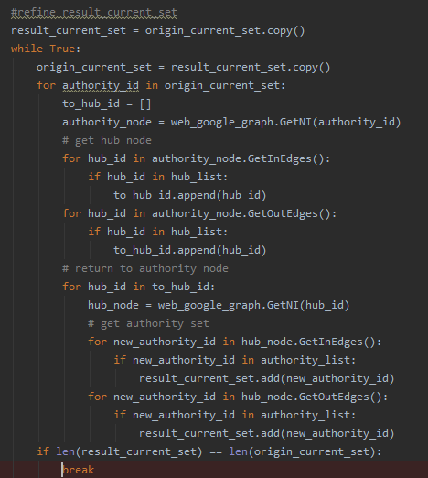
SALSA
3. Refine each sub sets by walking again

Slide 36
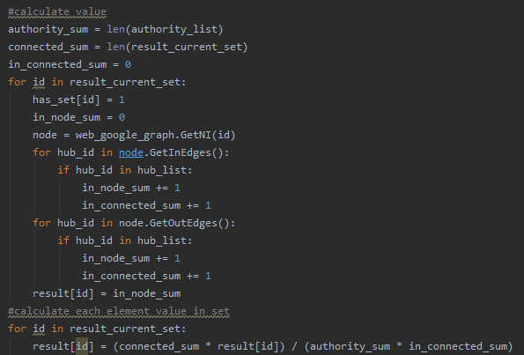
SALSA
4. Calculate value

Slide 37
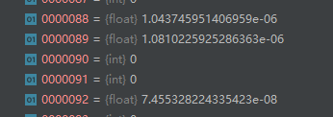
SALSA
Results
We only calculate each value of elements in the first connected graph set because of some factors.
Some results of first connected graph
Page 537039 has the highest value in the first connected graph, with value 0.00023678...

Slide 38

Reference

Slide 39
Reference
1.Brin, S. , & Page, L. . (1998). The anatomy of a large-scale hypertextual web search engine. Computer Networks and ISDN Systems, 30(1-7), 107-117.
2.Gyöngyi, Z., Garcia-Molina, H., & Pedersen, J. (2004). Combating Web Spam with TrustRank. Thirtieth International Conference on Very Large Data Bases.
3.Lempel, R. , & Moran, S. . (2000). The stochastic approach for link-structure analysis (salsa) and the tkc effect. Computer Networks, 33(1-6), 387-401.

Slide 40
Thank you！
Teacher：Peng Wang
Group：1
Date：10/8/2019

